Slide 1


STUDYING THE MEOW MEOW OF MESOSCALE CATS
Master of Science in Environmental Meteorology
29° October 2024
Candidate: STORER Alessandro
Matriculation 240734
Supervisor: PASQUERO Claudia
Internal Supervisor: ZARDI Dino

Slide 2
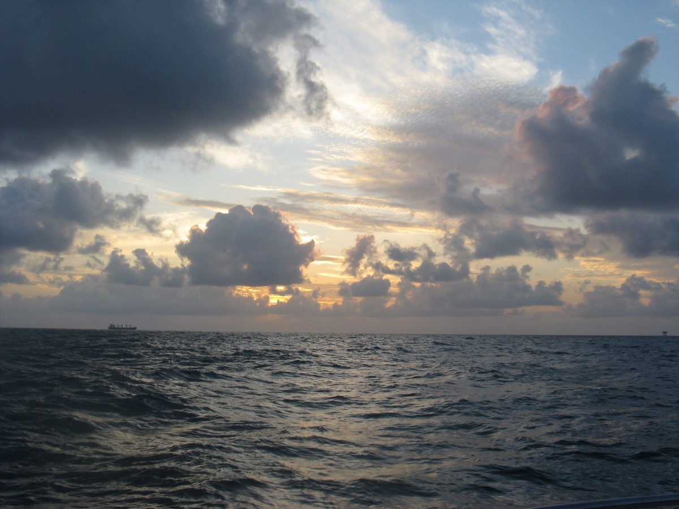
Humidity
Radiative balance
Convective
organization
wind
SST
Turbulent fluxes
currents
Notes:
the coupling between marine shallow
trade-wind clouds and circulation is known to play a cen-
tral role in the uncertainty of the tropical cloud feedback and climate sensitivity estimated by models

Slide 3
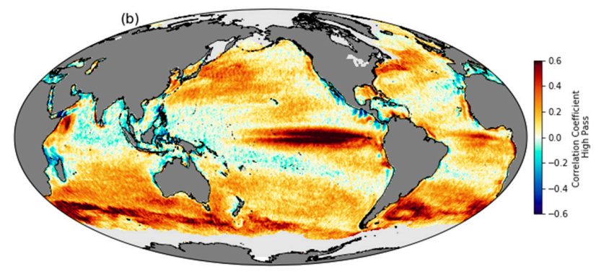
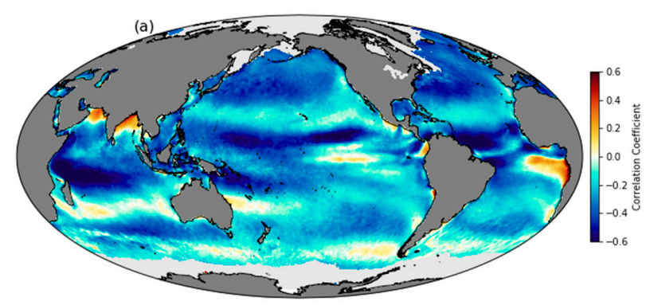
INTRODUCING THE LOCAL SCALE
Correlation between QuikScat wind speed and NOAA Optimum Interpolated SST using daily, 25-km-gridded data from 2000–2009.
Same, but for 1000km high-pass filtered data: notice the thorough change of correlation signs.
Gentemann et al. 2020

Slide 4
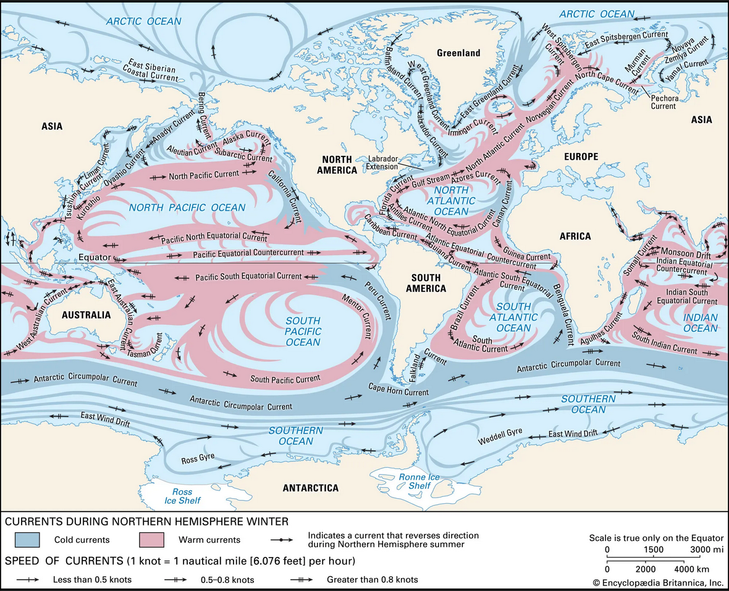
Be honest : How often do you think about oceans?

Slide 5
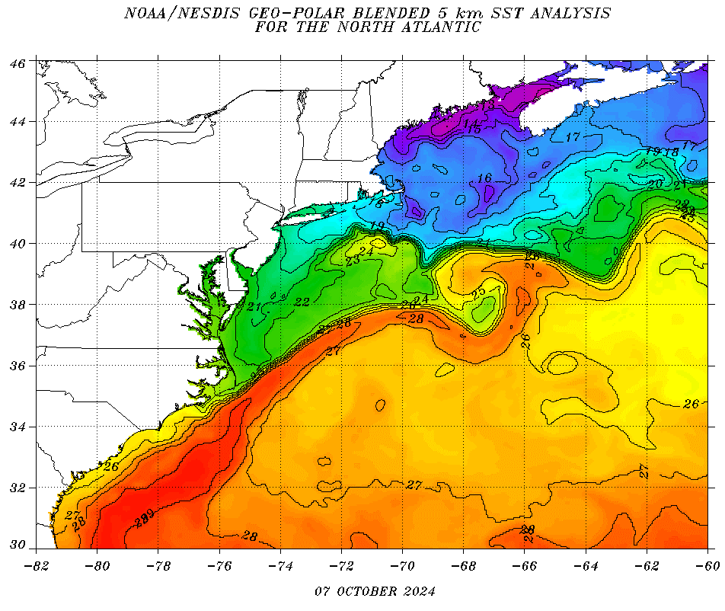
The Gulf Stream case
OPERATIONAL DEFINITION OF OCEANIC MESOSCALE
Notes:
The literature on GS is immense, I really cannot dedicate much time on it: just know that it is so energetic

Slide 6
EUREC4A INTRO

Slide 7
My goals and simulation intro
Viz SST anomalies

Slide 8
RESPONSE OF THE AIR COLUMN

Slide 13
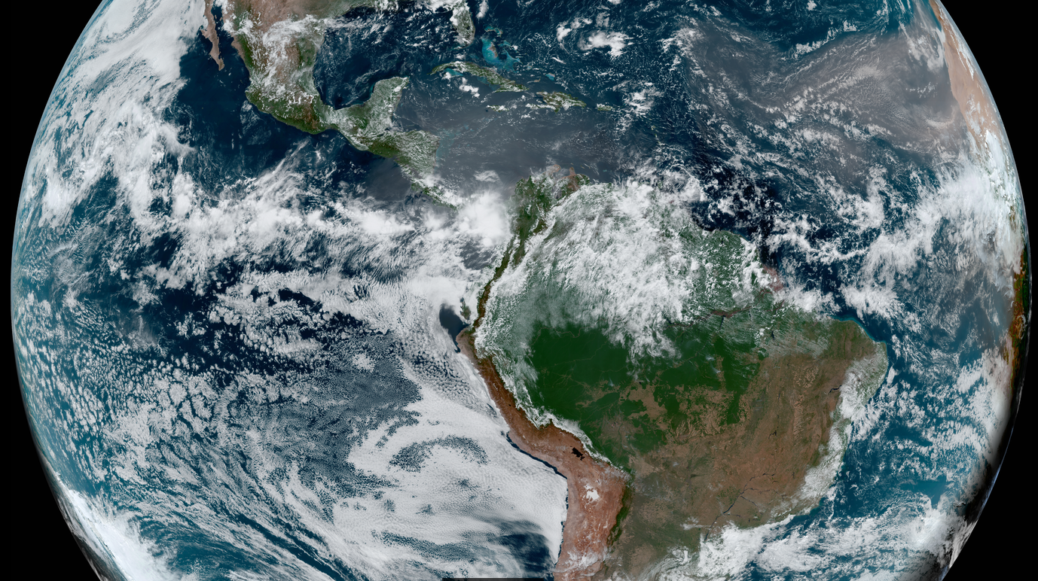

Slide 14
backups

Slide 15
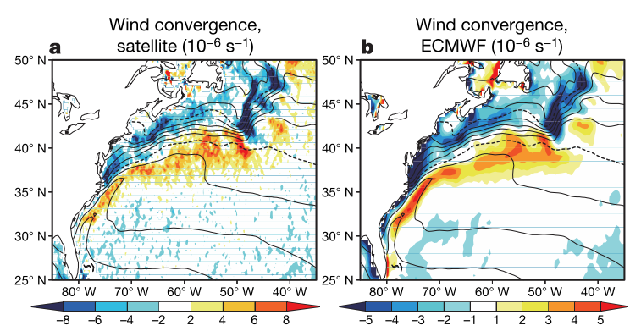
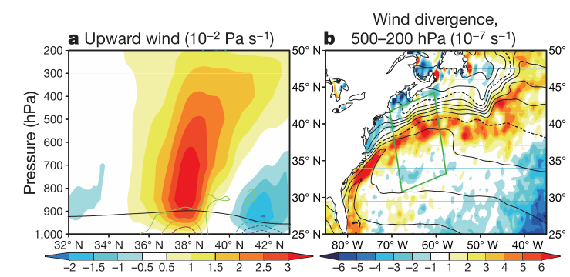
Not only MABL
GS is forcing the entire troposphere!
Minobe et al. 2010
Notes:
« to a surface convergence field, there corresponds a reaction by the whole troposphere

Slide 16
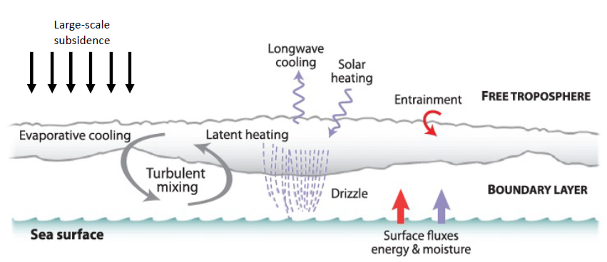
Credits: Allison Wing
WE CALL THIS
A COUPLED SYSTEM
Mettere magari un’immagine tratta da lavori su eurec4a

Slide 17
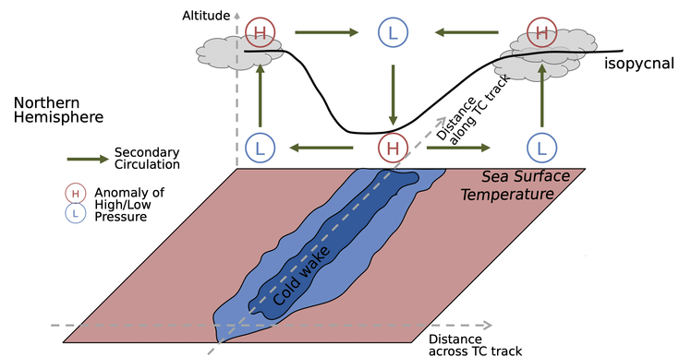
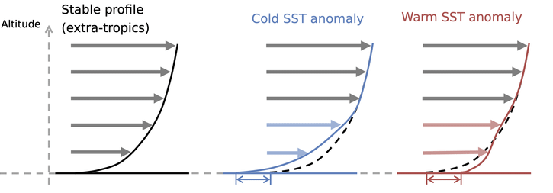
UNSURE ABOUT THIS SLIDE
TWO MAIN MABL RESPONSE MECHANISMS
Pressure Adjustment (PA)
THERMODYNAMIC FEEDBACK
Downward Momentum mixing (DMM)
$∇⋅\vec{u}=α_{PA}∇^{2}SST$
$∂_{r}u_{r}=α_{DM} ∂_{r}SST$
weak wind, neutral column
strong wind, unstable air
Secondary circulation
strong wind and
neutral stability conditions
Altitude
Mean profile
Wind speed
Pasquero et al. 2021, Desbiolles et al. 2023
Notes:
conditions relative to SST structure scale

Slide 18
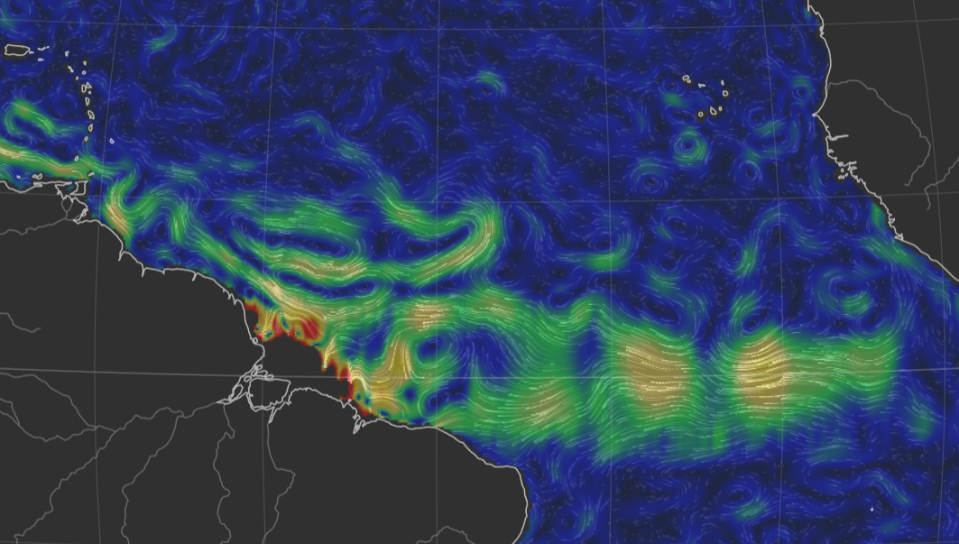
Reconstructed surface currents on 4th February 2020: peaks (yellow shadings) correspond to approx. 1m/s
Source: https://earth.nullschool.net/
Red box: the EUREC4A region
and computational domain

